Slide 1
10.009 Digital World
Week 4
Man, Geok See

Slide 2
Topics
Iteration with for-loop
More topics about list
More compound data types: dictionary, tuple

Slide 3
For Loop
When data are collected in a list, simpler to use for loop to perform the same operations on each element
Previous example: Suppose we need to print out a conversion table with Celsius degrees in the first column and corresponding Fahrenheit degrees in the second column:
In each pass of the loop, variable c refers to an element in the list, starting with cDegrees[0], before ending with the last element
c = 10
while c<=15:
f = 9.0/5 * c + 32
print c,f
c = c+1
cDegrees =[10,11,12,13,14,15]
for c in cDegrees:
f = 9/5.0 * c + 32
print c,f
10 50.0
11 51.8
12 53.6
13 55.4
14 57.2
15 59.0

Slide 4
For loop
Any for loop can be implemented as a while loop (not vice versa)
for element in somelist:
<process element>
index = 0
while index < len(somelist):
element = somelist[index]
<process element>
index = index + 1

Slide 5
For loop
Use range() to create a list for the for-loop
range(start, stop, inc) generates a list of integers start,
start+inc, start+2*inc, and so on up to, but not including,
Stop
range(stop) is the same as range(0, stop, 1)
>>> range(3) # = range(0, 3, 1)
[0, 1, 2]
>>> range(2, 8, 3)
[2, 5]
But range can only create integer list
(how to create: [10.0, 12.5, 15.0, 17.5, 20.0])
cDegrees=[]
for k in range(5):
c = 10 + k * 2.5
cDegrees.append(c)

Slide 6
For loop with loop indices
Instead of iterating a list directly with the for-loop construction, we can equivalently iterate the list indices and index the list inside the loop
Why this is useful: when we need to process two (or more) lists simultaneously
Example: write a function to compute the element-wise addition of two lists
for element in somelist:
<process element>
for index in range(len(somelist)):
element = somelist[index]
<process element>

Slide 7
Element-wise addition (operation) of two lists
Need to iterate the list indices and index the list inside the loop
More compact programming construct with list comprehension / zip() [do not need to know in DW]: http://stackoverflow.com/questions/18713321/element-wise-addition-of-2-lists-in-python
  But idea is similar
a=[1,2,3]
b=[4,5,6]
sumList=[]
for idx in range(len(a)):
sumElement = a[idx] + b[idx]
sumList.append(sumElement)

Slide 8
Change list elements
Adding 5 to all elements, does this work? Why?
cDegrees =[10,11,12,13,14,15]
for c in cDegrees:
c = c+5

Slide 9
For Loop: Summary
for element in somelist:
<process element>
Advantage: compact and intuitive to walk through a list
Limitation:
  Not easy to change list element: instead, iterate list indices and index list element
  As it is, not easy to perform element-wise operation on multiple lists (advanced Python: use zip())
  Mostly work for list, still need while-loop for other repetitive processing
ans = int(raw_input('what is 1+2 ? '))
while ans != 3:
ans = int(raw_input('what is 1+2 ? '))
print 'ok, you get this eventually'

Slide 10
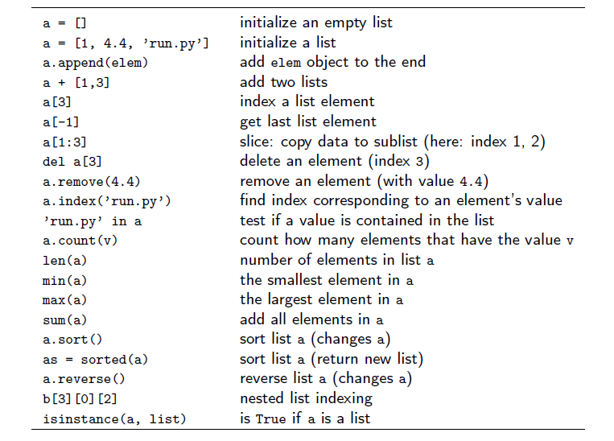
Basic List Operation

Slide 11
List Representation in Memory, List Mutation and Shared Structure
Global / local tables (binding environments) specifies association between variable names and values
For list (complex data structure), the variable name is associated with the memory address of the structure (pointer)
Important when the data structure is mutable (we can change the value of the data structure)
  Mutable: List, dictionary
  Immutable: Tuple, String
  Pointer copying allows data structure sharing. For mutable data structure, this may lead to side effect - aliasing
Variable | Value (object)
a | 1
b | 2.4
c
a=1
b=2.4
c=[1,2,3,4]
1 | 2 | 3 | 4

Slide 12
List Representation in Memory, List Mutation and Shared Structure
Aliasing, copy, deepcopy:
  a=[1, 2, [3,4]]
  b=a # share entire object
  c=a[:] # still share objects after top level
  d= copy.deepcopy(a) # nothing share
>>> a = [1,2,3,4,5]
>>> a[1:3]= [0] # this creates new object or modifies existing object?
# how to figure this out?
# share with another variable, or id()

Slide 13
Matrix, Nested List, Nested Loop
Matrices can be represented by nested lists: nested lists are list objects where the elements in the lists can be lists themselves
2x3 matrix A (two rows, three columns):
1 2 3
4 5 6
A(1,2) = 6 (first index is row, second index is col, start from 0)
>>> A = [ [1,2,3],
[4,5,6] ]
>>> A[1][2]
6
How to walk through every element of a matrix (nested list)?

Slide 14
Traversing Nested Lists
a =[[1,2,3],
[4,5,6]]
for list1 in a:
for x in list1:
print x
# iterate list indices
for rowIndex in range(len(a)):
for colIndex in range(len(a[0])):
print a[rowIndex][colIndex]
# in general, walk through nested list
a=[[1,2,3],
[4]]
for rowIndex in range(len(a)):
for colIndex in range(len(a[rowIndex])):
print a[rowIndex][colIndex]

Slide 15
Dictionary
A list is a collection of objects indexed by an integer: 0 to len()-1
Sometimes it is more handy to use text for indexing
Example: temperature of cities: Tokyo, Bangkok, Singapore
>>> temps = [13, 25, 30] # tokyo, bangkok, sg
# need to remember index 0 corresponding to tokyo, etc
>>> print temps[2] # sg

Slide 16
Dictionary
Dictionary ≈ A list where the index can be a text (or other immutable data type)
The string ‘indices’ in a dictionary are called keys
>>> tempsDict ={'tokyo':13, 'bangkok':25, 'sg':30}
# create a dictionary
>>> print tempsDict['sg']
30
>>>

Slide 17
Dictionary operation
>>> tempsDict ={'tokyo':13, 'bangkok':25, 'sg':30}
>>> #indexing
>>> print tempsDict['tokyo']
13
>>> len(tempsDict)
3
>>> print tempsDict
{'bangkok': 25, 'sg': 30, 'tokyo': 13}
#walk through a dictionary
>>> for city in tempsDict:
print city, tempsDict[city]
bangkok 25
sg 30
tokyo 13
# in general, the order of the returned list of keys is unpredictable

Slide 18
Dictionary
>>> tempsDict={'tokyo': 10, 'bangkok': 25, 'sg': 30}
>>> tempsDict['tokyo']=2
>>> tempsDict
{'bangkok': 25, 'sg': 30, 'tokyo': 2}
>>> t2 = tempsDict
>>> t2['sg']=15
>>> tempsDict
{'bangkok': 25, 'sg': 15, 'tokyo': 2}
>>>
Dictionary, List are mutable
  Objects whose values can change after creation
  Need to be careful with aliasing
String, Tuple, and most other Python objects are immutable
  Objects whose values are unchangeable once they are created

Slide 19
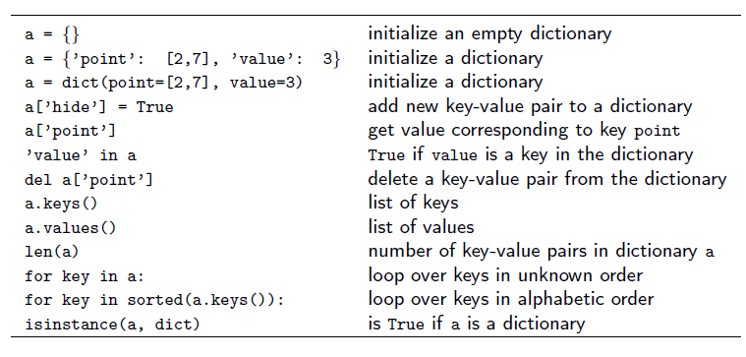
Dictionary operation

Slide 20
Dictionary with List / Dictionary as value
>>> a ={1:3, 2:[4,5]}
>>> a[2]
[4, 5]
>>> a[2][1]
5
>>> a ={1:3, 2: { 3:4, 5:6}}
>>> a[2]
{3: 4, 5: 6}
>>> a[2][5]
6
>>>
>>> a={1:3, 2:'hello'}
>>> a[2][1]
'e'
>>>

Slide 21
Look up
d = {'tokyo': 25, 'kl': 30, 'sg': 30, }
## look up using key
key = 'sg'
if key in d:
print d[key]
## look up using value
value = 30
for k in d:
if d[k] == value:
print k, d[k]
## add ‘break’ if print only first occurrence

